Slide 1
PowerShell and MS Graph API demystified
Michael Seidl
IT Process Automation Expert | au2mator | Microsoft MVP

Slide 4





Michael Seidl
Microsoft MVP (since 2015)
Automation Consultant (10+ Years)
Founder, CEO | au2mator
Self Service Portal for Microsoft Automation
Blog: www.techguy.at | www.au2mator.com
GitHub: github/seidlm | github/au2mator
/ SeidlM

Slide 5

AGENDA
Introduction
MS Graph API
WHAT, WHY, HOW
Authenticate, Quiz
Examples, Demo, Scripting
Q&A
END

Slide 6
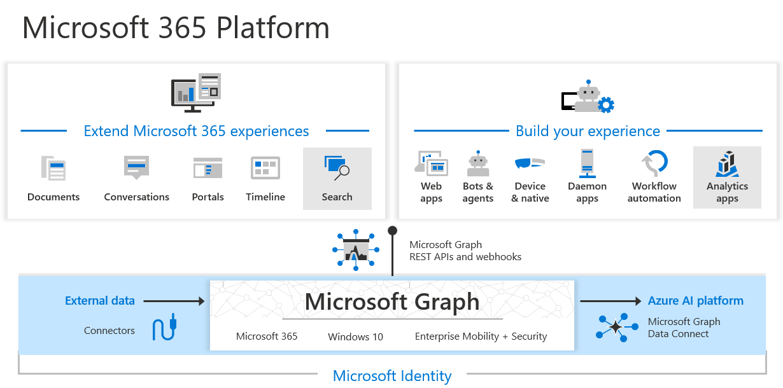
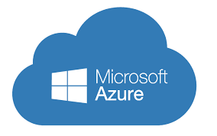
WHAT is MS GRAPH API
ONE API to the CLOUD
+

Slide 7
WHY use MS Graph API
No PowerShell Module
OnPrem/Cloud
More Functionality over PS-Module (delay)
Easy language
Unlimited Platforms
One API to all Cloud Services (Future)

Slide 8
HOW to use MS GRAPH API
REST Call, HTTP, WEB URL
https://graph.microsoft.com/v1.0/
Users | Groups | Teams | ToDo | Azure App …
GET, POST, PUT, PATCH, DELETE
Graph Explorer
JSON

Slide 9
Authenticate
Azure APP Registration
Client Secret or Certificate
Delegate or Application Permission

Slide 10


Delegate
Application
Signed In User
Effective permission (User, APP)
User/Admin Consent
No User
App Permissions only
Admin Consent only

Slide 11

QUIZ
Send Mail for a Group of users to send Mail from their Mailbox?

Slide 12
QUIZ
Newsletter to send from one specific Mailbox?

Slide 13
QUIZ
Send automatic Mails from personal Mailboxes by an internal application?

Slide 14

DEMO TIME

Slide 15
MORE
Teams Management
Endpoint Management
Send Mail
Azure App Reg, Permissions
AAD User Group, Orgmanagement
Audit Logs
SharePoint
Patches
…..

Slide 16
END is near
Examples on GitHub
https://github.com/Seidlm/Events
Use MS Graph API
Q&A
Contact
michael.seidl@au2mator.com
/SeidlM

Slide 19
Seidlm

